Slide 1
Name:Bidhya adhikari roll.no:026 class:bct a

Slide 2
Function overriding
The process of creating members in derived class with same name as that of visible members of base class is called overriding.
When a derived class or child class defines a function that is already defined in the base class or parent class, it is called function overriding . Function overriding helps us achieve runtime polymorphism. It enables programmers to perform the specific implementation of a function already used in the base class.

Slide 3
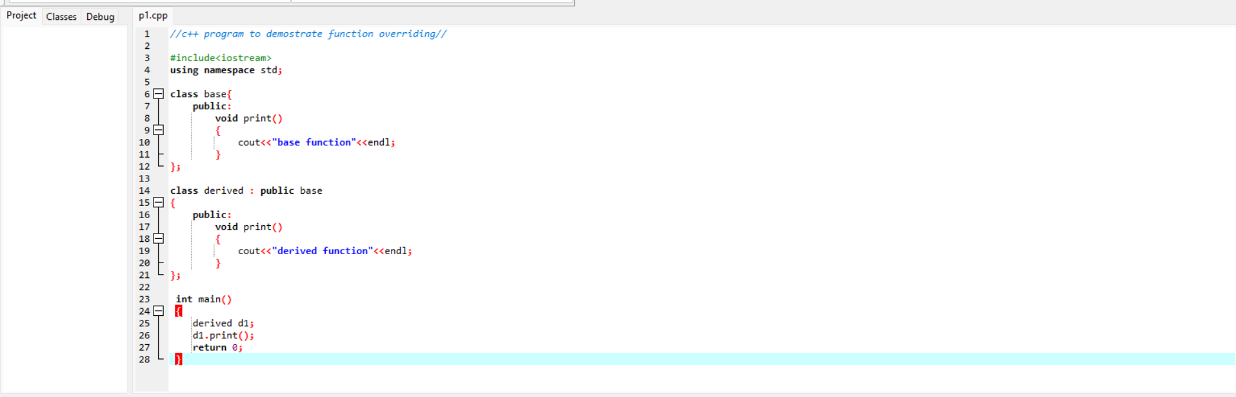
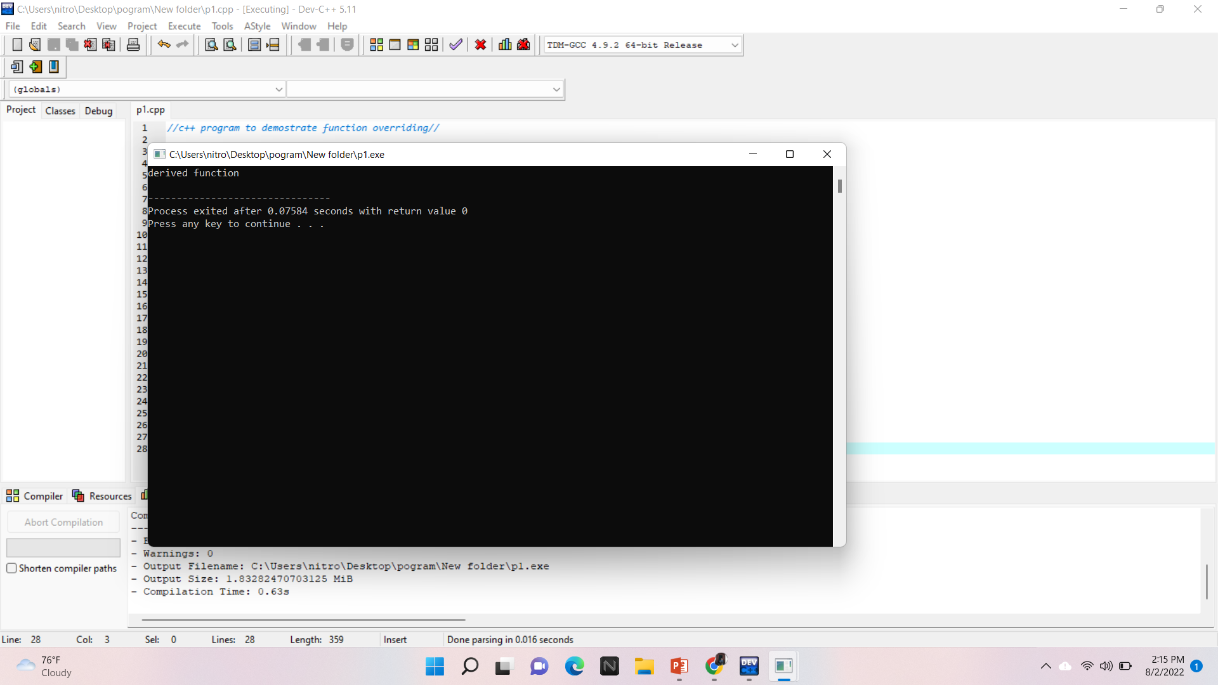
the example given above. Here the parent class is “Base” and the child class is “Derived”.
The output of the above program will be:
Derived Function
The function print() is declared in both the Base and Derived classes. When we call the function print() through the Derived class object, “d1”, the print() from the Derived class is invoked and executed by overriding the same function of the Base class.

Slide 4
How to access Overridden Functions in C++?
We must use the scope resolution operator, “::” to access the overridden function. Another way to access the overridden function is by using the pointer of the base class to point to an object of the derived class and calling the function through the pointer.

Slide 5
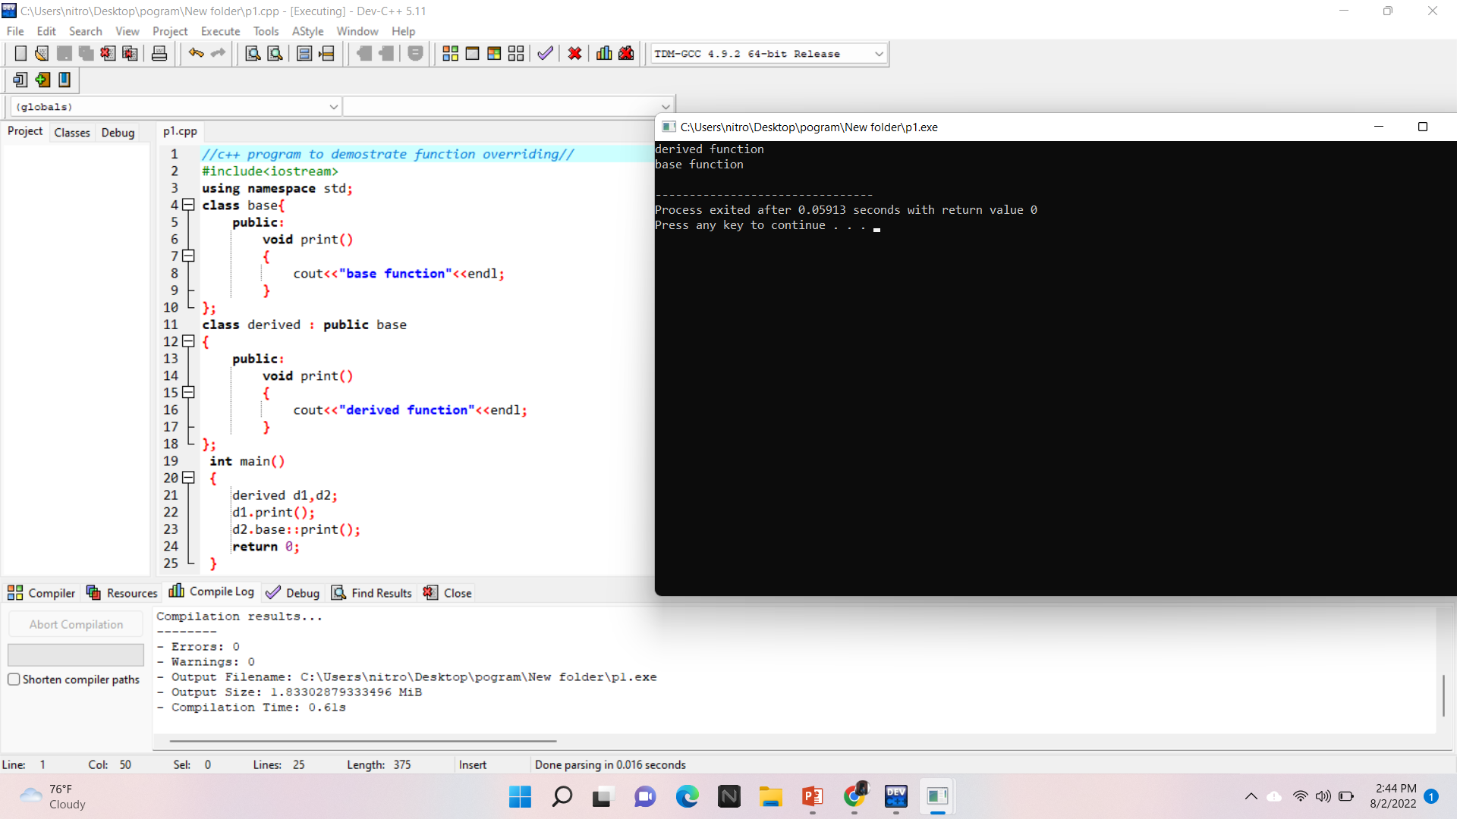
The output of the above program will be: Derived Function Base Function

Slide 6
Here the statement d1.print() accesses the print() function of the Derived class and the statement d2.base::print() accesses the print() function of the Base class.
CALLING a C++ overridden function from the derived class
In this code, we call the overridden function from within the Derived class itself.

Slide 7
Thank
you

